Slide 1
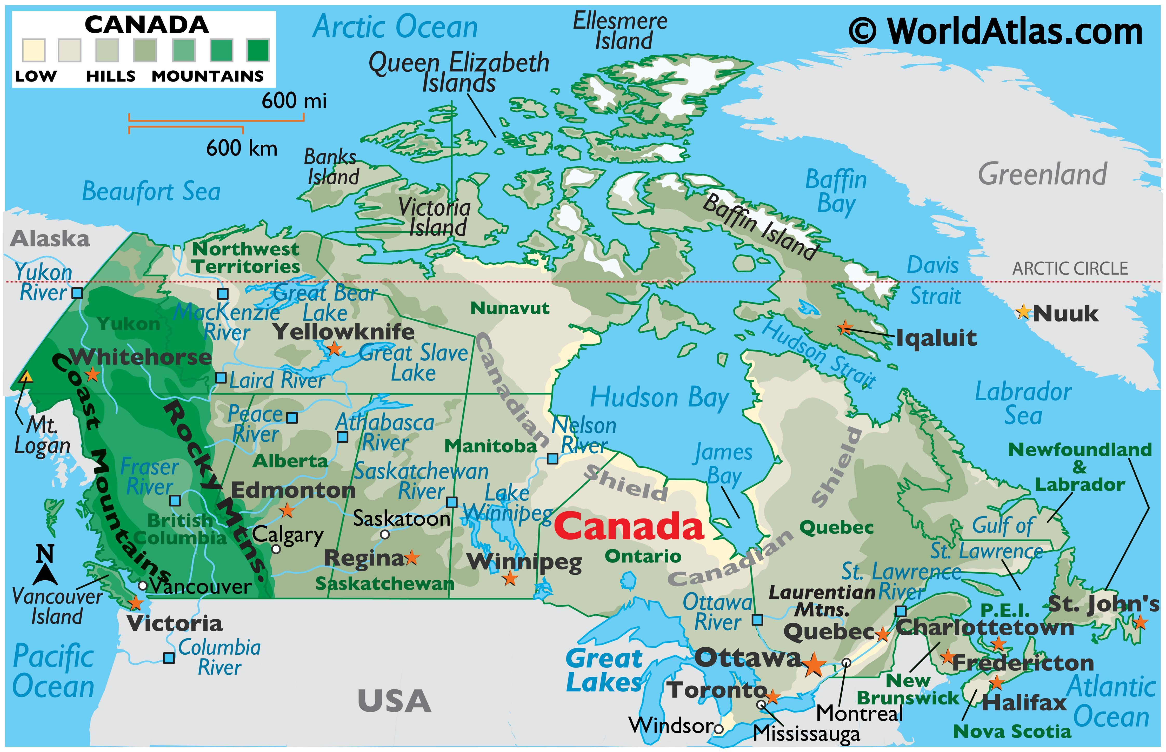

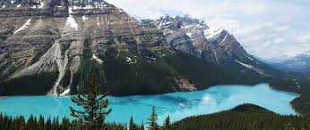
Canada
March 6-10

Slide 2
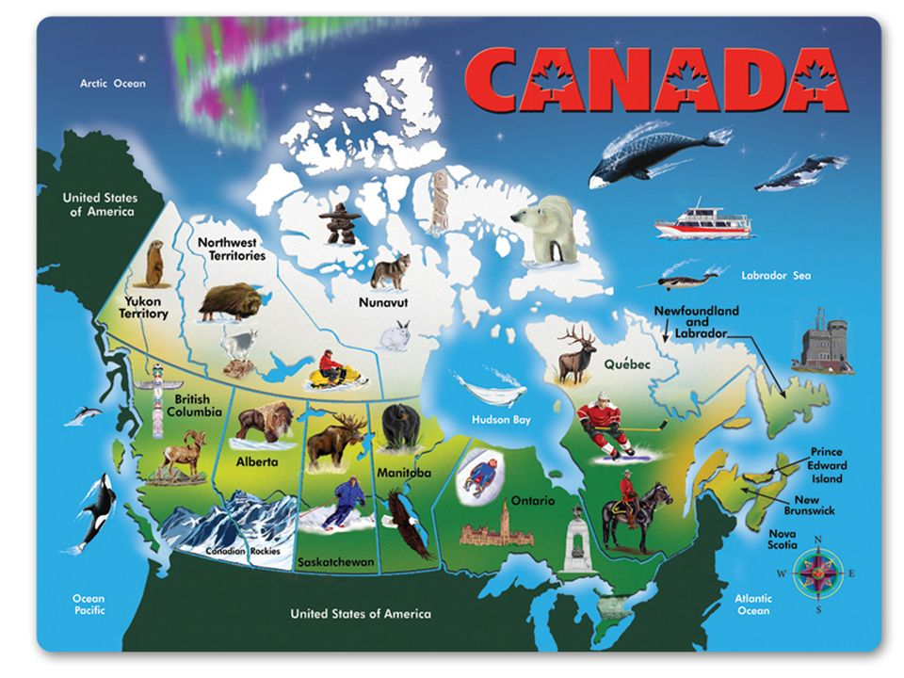

Slide 3
SS6G4 Locate selected features of Canada.
Locate on a world and regional political-physical map: the St. Lawrence River, Hudson Bay, Atlantic Ocean, Pacific Ocean, the Great Lakes, Canadian Shield, and Rocky Mountains.
b. Locate on a world and regional political-physical map Canada and the province of Quebec.
SS6G5 Explain the impact of location, climate, distribution of natural resources, and population distribution on Canada.
a. Describe how Canada’s location, climate, and natural resources impact trade and affect where people live.
SS6G6 Explain the impact of environmental issues in Canada.
a. Explain the causes and effects of pollution and acid rain in Canada to include the Great Lakes.
b. Explain the causes and effects of the extraction of natural resources on the Canadian Shield (e.g., mining and logging).

Slide 4
 | Monday 6 | Tuesday 7 | Wednesday 8 | Thursday 9 | Friday 10
Focus Standard(s) | SS6G4 | SS6G4 | SS6G4 | SS6G5,G6 | SS6G5,G6
Learning Target(s) | Canada’s Physical Features | Canada’s Physical Features | Canada’s Physical Features | Climate, resources impact trade | Climate, resources impact trade
Opening | Canada Map(Practice) | Canada Map(Practice) | Canada Map(Practice) | Canada Map(Practice) | Canada Map(Practice)
Work Session | Cloze Notes (Canada) Textbook p.232-250 Work to complete projects: (MLK/LAL) and Countries | Cloze Notes (Canada) Textbook p.232-250 Work to complete projects: (MLK/LAL) and Countries | Cloze Notes (Canada) Textbook p.232-250 Work to complete projects: (MLK/LAL) and Countries | Cloze Notes (Canada) Textbook p.232-250 Work to complete projects: (MLK/LAL) and Countries | Cloze Notes (Canada) Textbook p.232-250 Work to complete projects: (MLK/LAL) and Countries
Closing | TOD | Think-Pair-Share | TOD | Think-Pair-Share | Group Discussion
Minor Assignments Due |  |  | Quiz #7 |  | MLK/LAL Worksheet Packet Due
Major Assignments Due
Current Relearning & Reassessment Assignments (with due dates)
Vocabulary
Upcoming Major Assignments |  | Social Studies Project (Latin American Country/Island) incorporate language, religion, resources, environmental issues, government, economy, and history. MLK/LAL Project: research paper and graphic organizer will be given to students

Slide 6
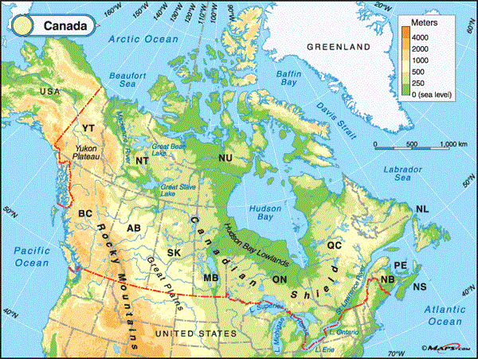
Locate on a world and regional political-physical map: the St. Lawrence River, Hudson Bay, Atlantic Ocean, Pacific Ocean, the Great Lakes, Canadian Shield, and Rocky Mountains.

Slide 7
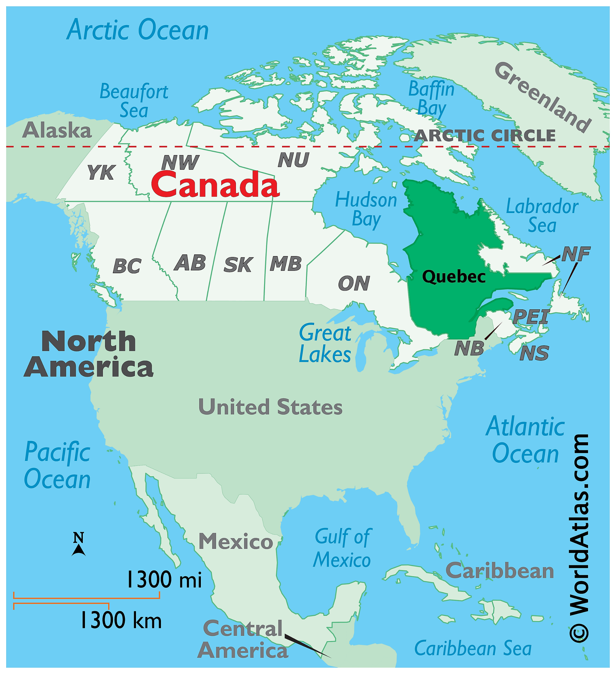
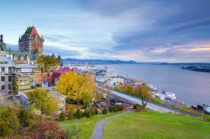
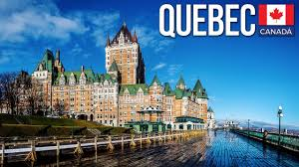

Slide 8
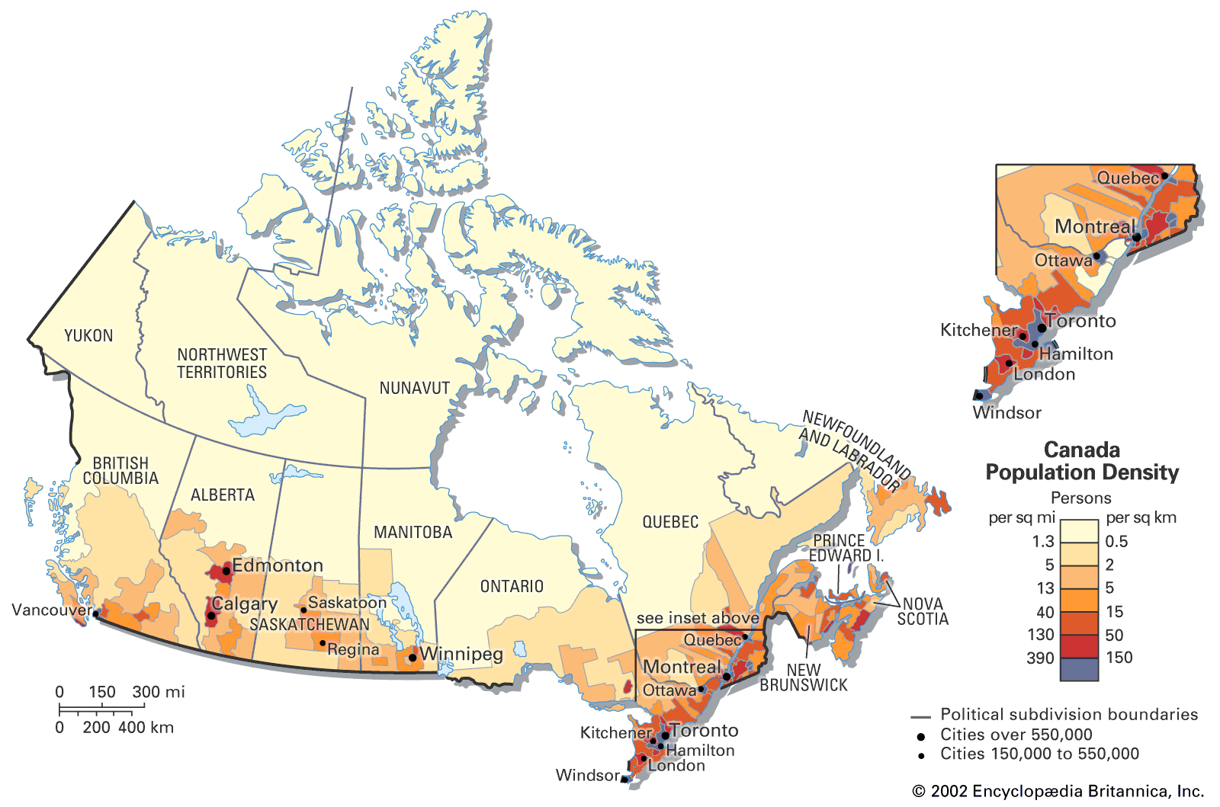

Slide 9
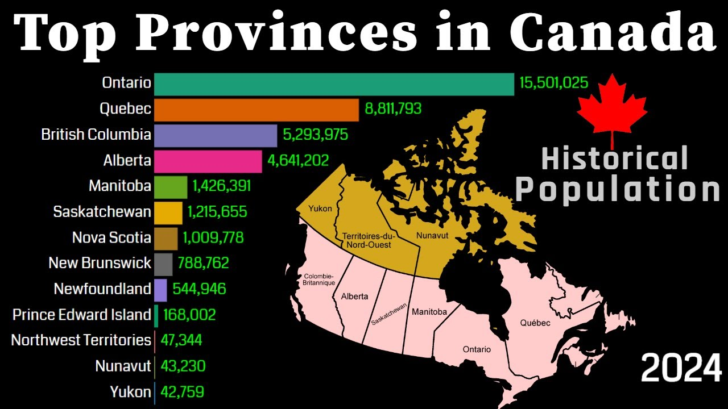

Slide 10
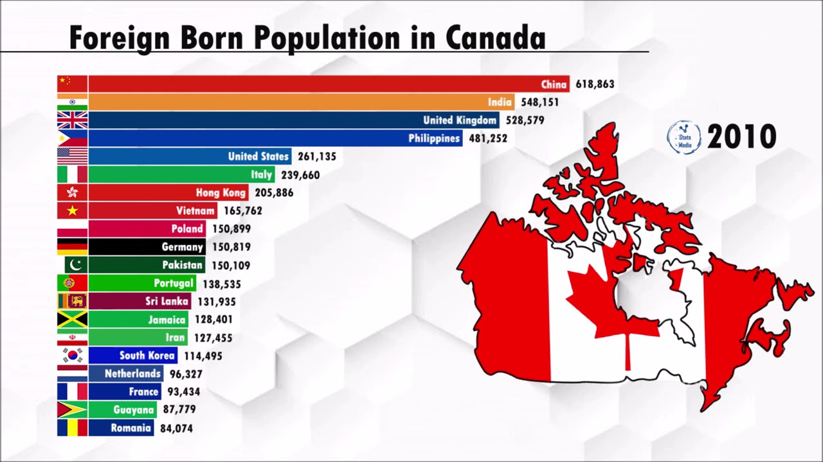

Slide 11
